Slide 1
Creating A Music Player Using Doubly Linked List In C
Group Number: 15
Topic Number: 16
Members:
Navya P Hegde PES2201800399
KS Koulini PES2201800399

Slide 2
Our Code Consists Of…
The code written consists of two main parts:
Code dedicated to playing the music file and related functions such as loading music, pausing music, resuming music etc.
Implementation of Doubly linked list to mimic functionality of the music player

Slide 3
Playing the Music File:
In order to read, interpret and play a music file from the C program the SDL2 and SDL_mxier library header file is included in and linked with the C program.
#include <SDL_mixer.h>
SDL or Simple DirectMedia Layer is a cross-platform software development library design to provide a hardware abstraction layer for computer multimedia hardware components. It is often used as game development library and is compatible with many operating systems such as Android, iOS, Linux, macOS, and Windows.
The SDL_mixer library is a branch of the SDL library that is used to load music files dynamically and has the ability to load multiple music files on multiple channels.

Slide 4
SDL_mixer functions used
int Mix_OpenAudio(int frequency, Unit 16 format, int channels, int chunksize)
This function is used to play all subsequent music files at the specified frequency, read from a 16 bit samples in either the format of big endian, little endian or the formal supported by the system. The function returns -1 upon failure and 0 on success.
Mix_Music * Mix_LoadMUS(const char *)
This function takes a constant character array containing the absolute or relative path of the song to be loaded and returned a pointer to a dynamically allocated memory block that can interpret the file.
Void Mix_PlayMusic (Mix_Music * song ,int loop)
The function plays the music file stored in the memory location whose address is given by the Mix_music pointer. The function will play the song from the start every time it is called. It is a void returning function

Slide 5
Void Mix_PauseMusic ()
If a music file is currently being played the Mix_PauseMusic() function pauses the song.
Void Mix_ResumeMusic()
If a music file is currently paused calling this function will resume playing the song from the point where it was stopped.
int Mix_PausedMusic()
If a music file is currently paused the function returns 1 else the function returns 0.
int Mix_PlayingMusic()
If a music file is currently playing the function returns 1 else the function returns 0.
void Mix_CloseAudio()
Used to close the current audio file being played.
void FreeMusic(Mix_Music * song)
frees the Mix_Music pointer.

Slide 6
Code Logic
In order to implement a music player using a linked we chose to represent each song that is entered into a single playlist using a node. The linked list containing these nodes represents the playlist. Each node in the linked list can be rearranged, insert and deleted as per preference to mimic the flexibility offered by a playlist

Slide 7
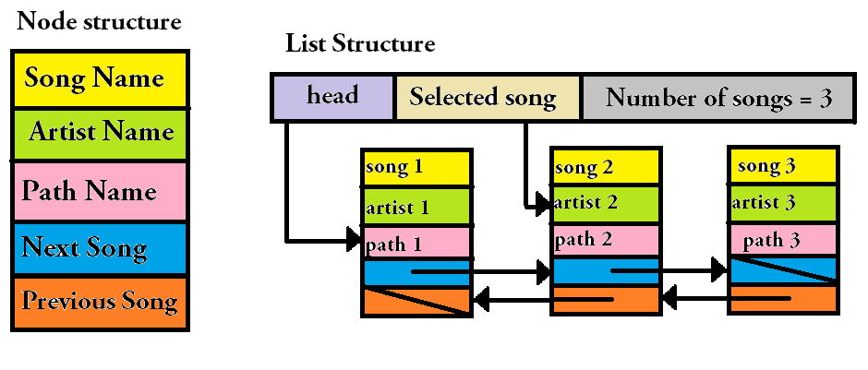

Slide 8
Structure Definitions:
Node structure
Playlist structure
typedef struct snode
{
char *Path;
char *Name;
char *Artist;
struct snode * next;
struct snode *prev;
}Snode;
typedef struct song_list
{
Snode *head;
Snode *selected;
int number_of_songs;
}Slist;

Slide 9
Initialize and insert functions
Slist * initialize(); //initializes members of the the list
Snode * create_node(char Path[],char Artist[]); //creates the new node
void insert_beg(Slist * list,char * Path,char * Artist);//inserts node at the beginning
void insert_end(Slist *list, char *Path, char *Artist);//inserts node at the end
void insert_at(Slist *list, int pos,char *Path,char * Artist);//inserts node at given position

Slide 10
Delete functions
int delete_at(Slist *list,int pos); //deletes node at the given position
int delete_end(Slist *list);//deletes node at end
int delete_beg(Slist * list);//deletes the node at the beginning

Slide 11
Playlist functions
int delete_song(Slist *list,int flag); // chooses which delete function to call
void insert_song(Slist *list,int flag); //chooses which insert function to call

Slide 12
Search and Display functions
int search_artist_single(Slist *list,char Artist[]);
int search_artist_all(Slist *list,char Artist[]);
int search_name(Slist *list,char Name[]);
void show_playlist(Slist *list); //Displays the play-list

Slide 13
Music funtions:
Playing music -> Mix_PlayMusic()
Pausing music -> Mix_PauseMuisc()
Resuming music -> Mix_ResumeMusic()
Going to next track -> int next_song(Slist *list)
Going to previous track -> int prev_song(Slist *list)
Current node selected -> int get_selected(Slist *list)

Slide 14
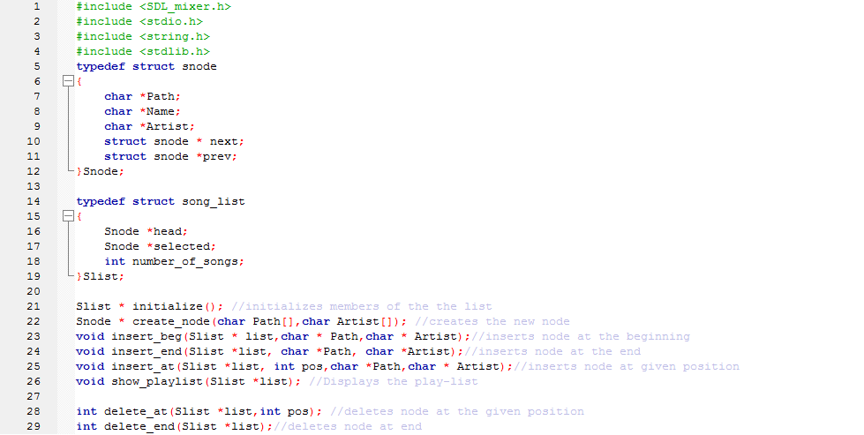
Code Snippets

Slide 15
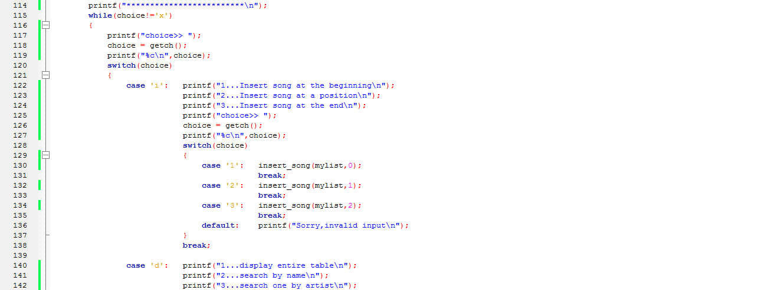

Slide 16
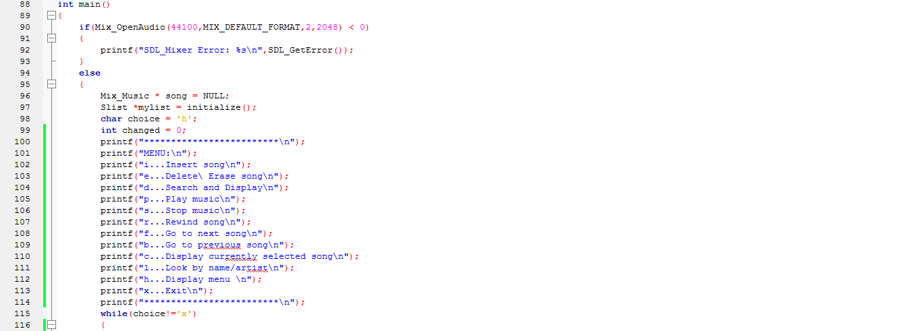

Slide 17
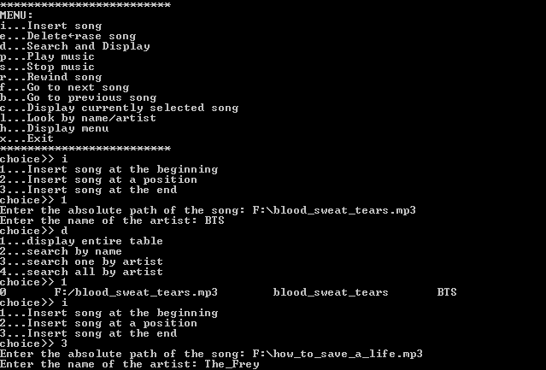
O
U
T
P
U
T

Slide 18
